Slide 1
Pirates travel index
Created by Chris Nguyen, Hazel Despain, Nathan Wong, Hayley Jellison

Slide 2
Problem statement
As a team of high-tech pirates, we want to know what are the best places to target to rob tourists with too much money
Online top tourist destination lists by bloggers are too subjective. We want to use data!
Goals:
create maps that track amount of tourists and how much they are spending to try to discover patterns in their behavior
use the annual World Happiness Report to see if there are any qualities that may contribute to tourism for cities
rank the top 10 tourist destinations according to number of tourists, expenditures, and their density index (i.e. number of tourists vs. local population ratio)

Slide 3
Data collection process
Get Mastercard Global Destination Cities Index (GDCI) PDFs and scrape data using Excel mobile app (take pictures and transform to Excel tables)
Collect other data from sources (U.N., World Bank, World Happiness Report). Already in table format so also good candidates for SQL tables
Use SQLAlchemy to write data to Postgres database in Heroku (10k row limit on free tier)

Slide 4
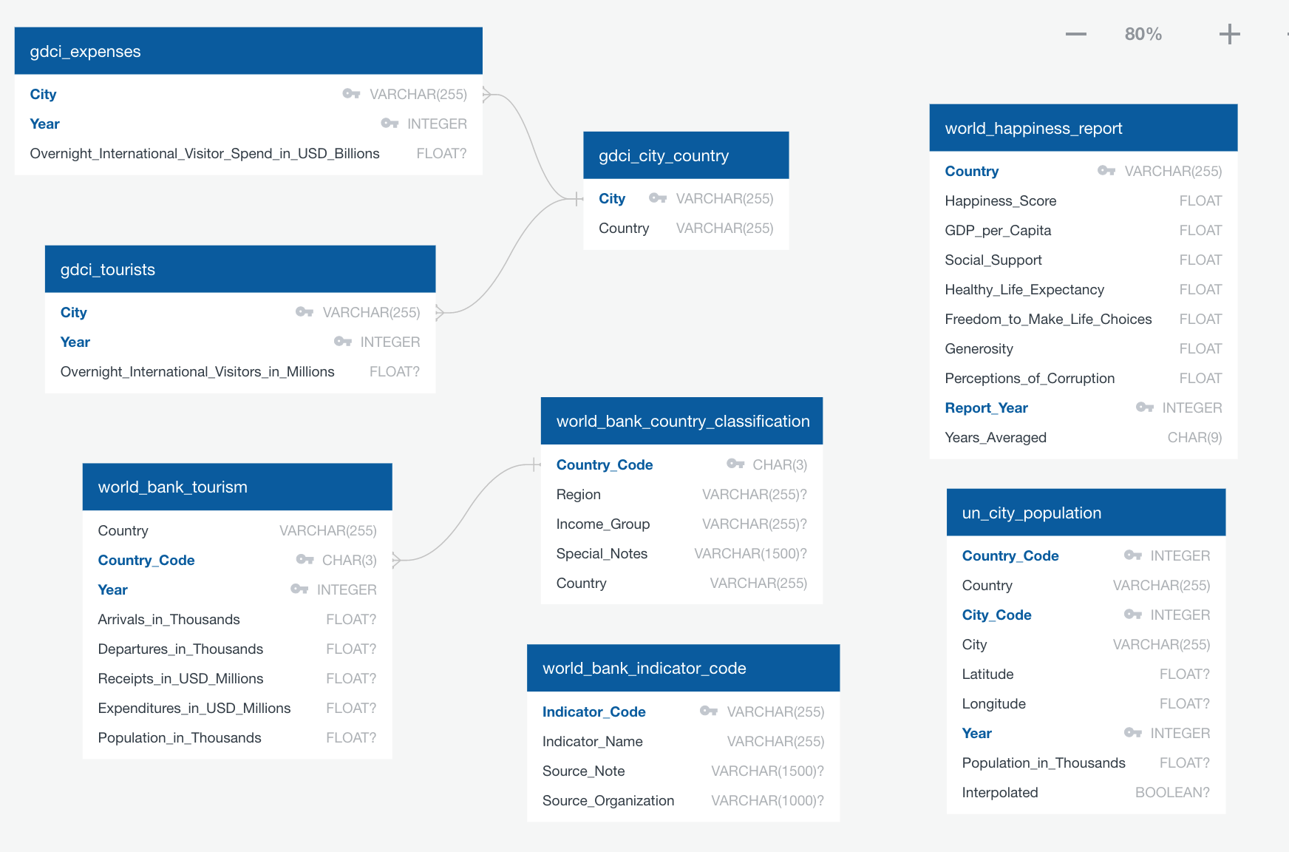
Data cleaning process
Inconsistent data to be fixed (ex: country names)
Inconsistent units (ex: millions vs. thousands)
Missing years resulted in missing data (solved by interpolation)
Pipe data to Flask endpoints to retrieve and return for visualizations

Slide 5









Interpolation

Slide 6
Demo
https://pirates-travel-index.herokuapp.com/

Slide 7
Data sources & resources
https://newsroom.mastercard.com/wp-content/uploads/2019/09/GDCI-Global-Report-FINAL-1.pdf
https://worldhappiness.report/
https://data.worldbank.org
https://population.un.org/wup/Download/
https://population.un.org/wup/Download/Files/WUP2018-F12-Cities_Over_300K.xls
https://d3plus.org/
https://api.mapbox.com/styles/v1/tempgeocent/cj2qe6qid003a2rmrquvqgbcx.html?title=true&access_token=pk.eyJ1IjoidGVtcGdlb2NlbnQiLCJhIjoiY2l1YTNmenEyMDAwdDJ6cWZxbG55Yjg4OSJ9.QRTz4Pi3096MtXKc_QgpWQ#15/37.0229/-76.34211

Slide 8
Future possible work
Look at country level tourist arrivals (we only looked at certain cities in this analysis)
Compare country level arrivals/departures
Compare tourist expenditures vs receipts
If we had perfect data:
Look at seasonal tourist trends in each country/city
Look at which countries tourists are coming from to see top destinations from each country
Look at average length of stay in each country/city
Look at small town tourism

Slide 9
Q/A

